Slide 1
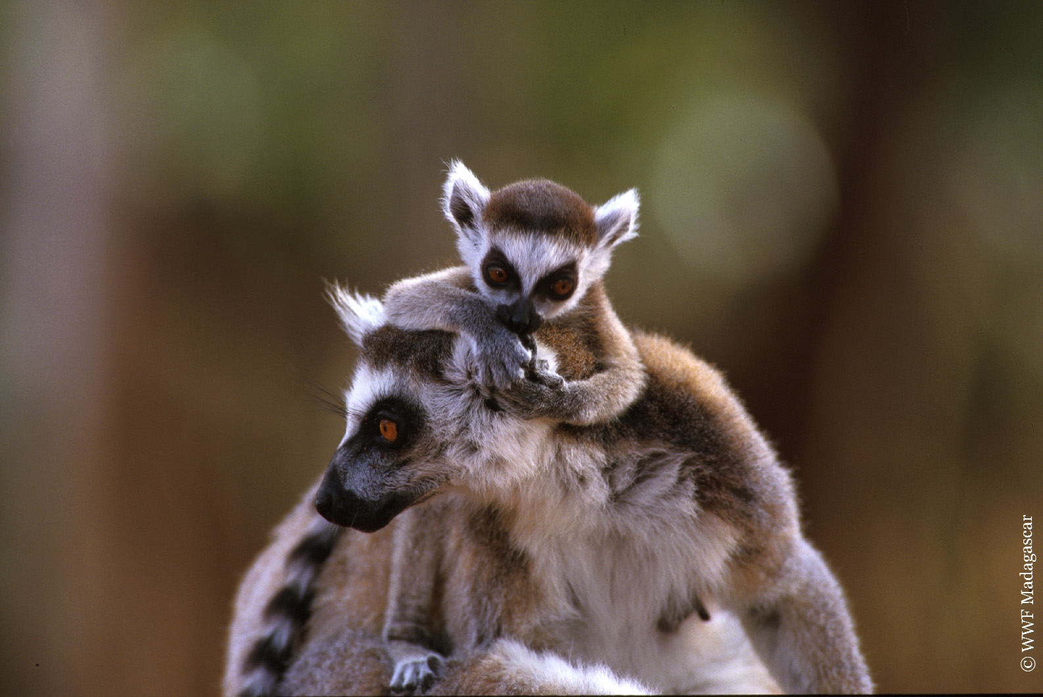

Green Infrastructure in Madagascar
investing for the sustainable development and inclusive growth
NatCap Symposium – Stanford University
20-23 March 2017
Tiana Ramahaleo - WWF MDCO
Roland Eve - WWF
Notes:
The green infrastructure idea in Madagascar comes from our experience as “firefighter”. This is a metaphor of course. Even if we manage to stamp out some threats in some areas and manage to maintain a blocks of forest or a specie here and there, most of the time new threats, new problems pop up in another part of the country and we often end up running behind those problems like a fireman trying to extinguish the fire. Of course this is not efficient, and even if it is honorable, we want to move to fire prevention and keep our forest, our lemur, and fish stock intact to support the livelihood of many rural people
This is then a proactive approach to preserve the remaining natural ecosystems and habitats in Madagascar and with it, we want to provide the government with a foundation on which they will base the sustainable development pathway the country is engaged in

Slide 2
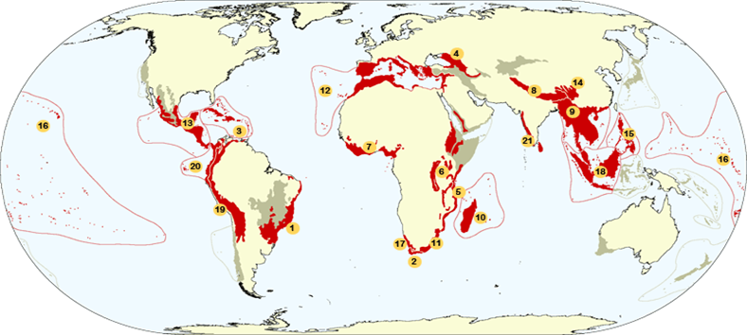
Madagascar overview
Madagascar 587.000 km2
Total population: 24 mio. Peoples, 78 % rural
Madagascar rank 180 of 189 countries (GDP/Capita, global finance 2016)
Population will double in 2040 (45 moi peoples)
One of the 17 mega-diverse countries representing 80% of world’s biodiversity
Third largest reef systems in world.
Very high level of endemisim (over 100 species of Primates (Lemurs) endemics
One of the 20th biodiversity Hotspot
Notes:
Madagascar is the fourth biggest island in the world with 587,000 square kilometer
There are 24 million of Malagasy people and most of them are rurals. it is projected that the population will double in the next 25 years. With this increase, we will expect an increase in the demands for food, fuel wood, agricultural land etc…
Madagascar is also a very low ranking GDP country
We are well known for our natural wonders: among the 17 megadiverse countries, comprising the third largest reef system after the great barrier reef and the coral triangle. Most of the fauna and flora species that you will encounter in Madagascar, as the lemurs, are unique and could not seen anywhere else in the world.

Slide 3
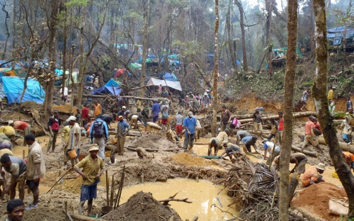
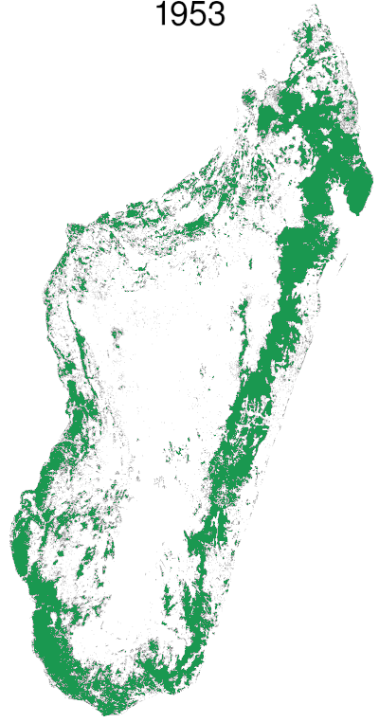
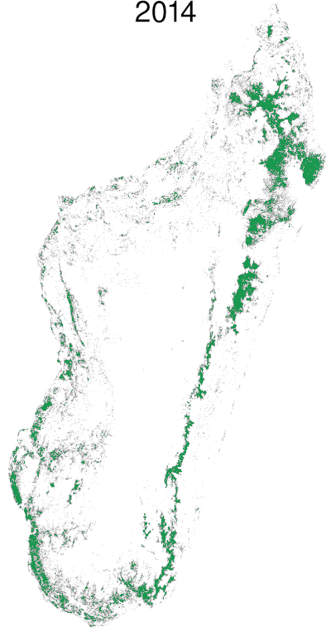
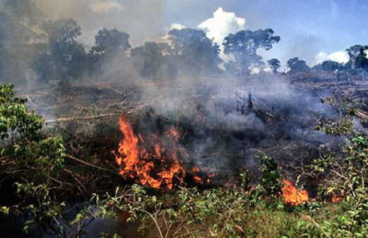
Critical situation
Erosion of 1.5% deforestation rate per year (2015)
Notes:
This rich biodiversity is highly threatened
The main environmental problem in Madagascar is a high rate and rampant deforestation : Madagascar losses 70,000 hectares every year due to : slash and burn cultivation, agriculture expansion, logging, illegal and small scale mining (for gemstones, gold) as you can see on the slide. A disturbing fact is : the gems and minerals are located just beneath the richest and remaining forests
As you can expect, this deforestation is accompanied by loss of services such as water, micro climate and fuelwood (more than 95% of Malagasy households rely exclusively on fuel wood for their domestic energy)

Slide 4
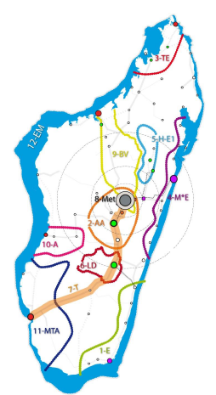
Why our policies failed to ensure sustainable development ?
National Development Plan and Land Used Plan issue in 2015
However
No integrated spatial approach
Environment considered as an after thought (Neglected Natural Capital value)
Reactive response to Natural Capital loss (siloed, isolated and costly response)
Localized site specific response to threath
Promoting Sustainable Development and inclusive growth
Based on :
Natural Capital
Infrastructrure Capital
Human Capital
12 Growth Poles identified
Notes:
Madagascar has been good in developing strategies, policies, legislations : for example in 2015, there was this new NDP that promotes sustainable development and inclusive growth (that’s the term the government uses to talk about green economy)
This document aims to found Madagascar’s development on three pillars: natural capital, infrastructure capital and human capital
12 development areas called “growth poles” have been identified. The growth poles are areas where the government will channel their funding and investments in the next few years to promote tourism, large scale agriculture, grey infrastructures such as road, energy plants, seaports…. They are shown in this slide.
So with such good documents, why we are still losing our forest and why the development has not really taken off? The main reason is in the HOW we implement these strategies and policies:
we are still stuck with a sectoral approach of doing things that does not help us to have an integrated spatial approach.
The environment is still considered as an “after thought” : in fact, in all investment processes, the environment or biodiversity is addressed once all decisions have been taken (except for protected areas).
In recent years, we have seen an increase in rushes of small scale mining and the government has often tried to go after each of them by sending gendarmes and policies to drive them out of the forests. The problem is that these interventions are costly, not effective (because people just go back when the gendarmes leave) and create broad frustrations as the government is perceived in those remote areas as someone trying to prevent people to improve their livelihoods and only present when problems exist.

Slide 5
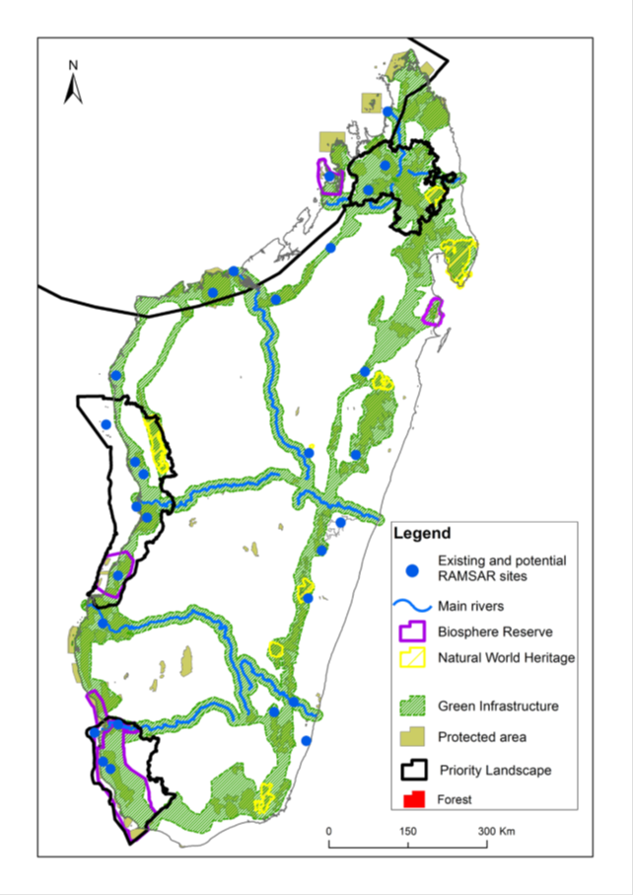
WWF proposal – green infrastructures network
Respond to Climate Change by building a national social and environmental resilience
Ensure the complementarity between the productiveness of green infrastructures (Natural Capital) and the market access of grey infractructures (roads…)
Apply Integrated Landscape Approach to high conservation areas
Consolidate the Country’s network of 122 PA by creating a connected green and blue infrastructure belt around the country
Notes:
So our idea is really to promote a strategic/proactive way to preserve the remaining forests and biodiversity in Madagascar and this is by promoting the concept of Green infrastructures. With the term “green” we also include the blue infrastructures. With the term infrastructures, we would like to change the perception of natural capital and bring them at the same levels as the grey infrastructures (roads, energy production sites, seaports…). This means that greens infrastructures are at the service of the country, something that you need to think about in the design of investments instead of thinking only about when everything is set.
The core idea of the green infrastructure is to build a network of protected areas around Madagascar that encompasses the last major remaining forest stands in the country. This gives a visual and spatial clue of where the most valued natural capital of the island are and constitutes a strong basis in our lobby to preserve them.
This concept has many advantages:
First , it helps to address climate change by building green corridor that will be key to maintain genetic flows between the dry west and humid east (300mmm rainfall in the west and 3,000 mm in the east), the high temperature in the south west and the mild temperature in the north east (4°C difference)
Second, the majority of the growth poles I mentioned before (areas where the government will focus its investments in the near future) are located near this green network. Most of them rely on ecological services that the adjacent forests or marine areas provide: tourism in the north west relies on the pristine reefs and scenery this region provides, the production of cocoa and vanilla in the north west relies on the health of the remaining forests as these cash crops require good forest stands and water etc. This overlap will help valorize the complementarity between the green and grey infrastructures and production system the government is planning to build. These production systems and the people who will be drawn there will need to be supplied with sufficient services (fuel wood for domestic energy, water, clean air…)
Third, The green infrastructure helps decision makers to address conservation in an integrated and spatial way. Based on this concept, WWF is applying for example a landscape approach to preserve the biodiversity in its four priority land and seascapes: the MHF landscape focuses on the preservation of the dry forest in the south west, the MTB in the west in centered on the preservation of one of the biggest mangroves stand of Madagascar and the Northern highland landscape is focusing on preserving the large track of humid forest in this area. WWF is developing some models on which the government can inspire from.

Slide 6
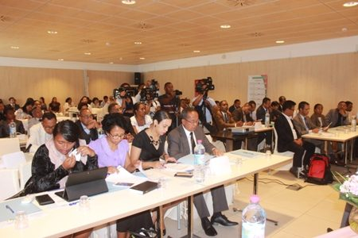
Madagascar Government adoption of the Green Infrastructure concept
Funding opportunities
GEF7 - Global Environment Facility
GCF - Green Cimate Funds
LDNF - Land Degradation Neutrality Funds
Government buy-in (November 2017)
The Ministry of Presidential Projects, Land Use Planning and Equipment launched the governement Green Infractuctures Action Plan
+
Notes:
So what has been done so far?
The good news is that the green infrastructure concept was adopted by one of the strongest and influential ministry of Madagascar (Land use planning and presidential projects). This adoption augurs a positive perception of the environment in the future. Through this adoption this ministry is planning to push the other government sectors to integrate the green infrastructures into their sectorial strategies and policies and most importantly use the Green infrastructure as the foundation for the upcoming “30-year vision on land use planning in Madagascar”.
We are just listing here the potential funding for this concept:
GEF 7: Madagascar has regularly benefited funding in the range of 25-30 million USD for biodiversity/land degradation and climate change focal areas from GEF ;
GCF: with WWF now an accredited entity and this concept’s strength on building a national ecosystem-based resilience and the good traction of this concept within the current government, we have good hope this concept will be submitted by Madagascar
Land degradation neutrality fund: this is a funding launched by the UN convention on land degradation in 2016 to provide loans to private investors to invest in the rehabilitation of land degraded. We are still learning about the way to secure this funding so if someone can clarify on this, we would appreciate greatly

Slide 7
Moving forward
Secure seed fund to move the process forwards
Develop the Green Infrastructures proposal
Funds raise to support Green Infrastuctures legal recognition and Landscape application
Notes:
So where to go next?
I am showing here the immediate steps to bring this concept forward:
We need to refine the concept, strengthen it with more scientific arguments (ecosystem services values, building scenarios to highlight the need to strategically preserve the green network…)
We need to develop a proposal for the funding opportunities I mentioned before: we are targeting between USD 100 to 200 million with a mix of source of funding (GEF; LDNF, GCF…)
Of course, fund raise. Back in Madagascar, I will have a meeting with the government on this concept and lay down a “the Green infrastructure action plan” with the concretes elements I got here in terms of ecosystem services valuation, scenario building etc.
Thank again to NatCap for having shown interest on our work and give us the opportunity to share and learn by inviting us the the symposium

Slide 8
